Slide 1
Why user research?
Course: User Research (TABG17-A17)
Lecture 1

Slide 2
What is user research?
“[…] the process of understanding the impact of design on an audience.” (Kuniavsky, 2003)

Slide 3
Why user research?
Who your users are
What their needs are
What they want
How they currently do things
How they would like to do them

Slide 4
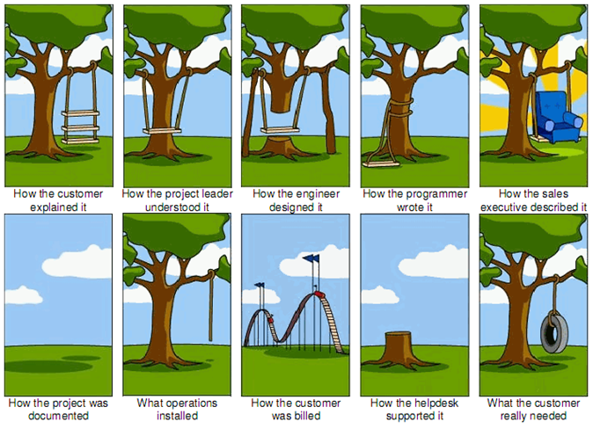
User-centered design

Slide 5
Common excuses
“You guys are the UX experts; don’t you know what you’re talking about? Why do we need to talk to users?” or
“We have all the information and data you need about our users.” or
“We know our users better than our users know themselves.” or
“Yikes. That sounds expensive.” or
“Can’t we design and then do research?” or
“Research seems to take a lot of time.”

Slide 6

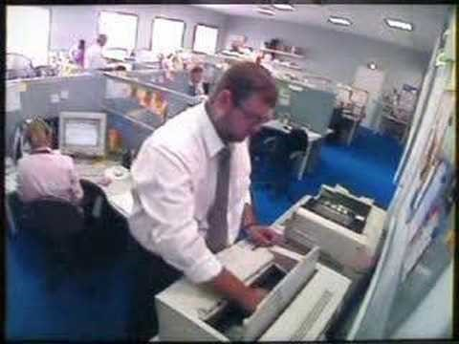
User research is important!
What you want to avoid:

Slide 7
Where do frustrations come from?
Cannot figure out how to do simple things
Many not frequently used functions
Many hidden functions
Operations outcome not visible

Slide 8
DESIGN IS DIFFICULT!

Slide 9
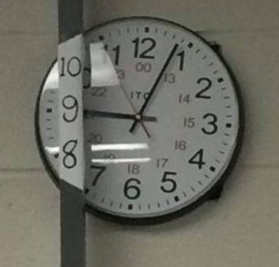
3D time?

Slide 10
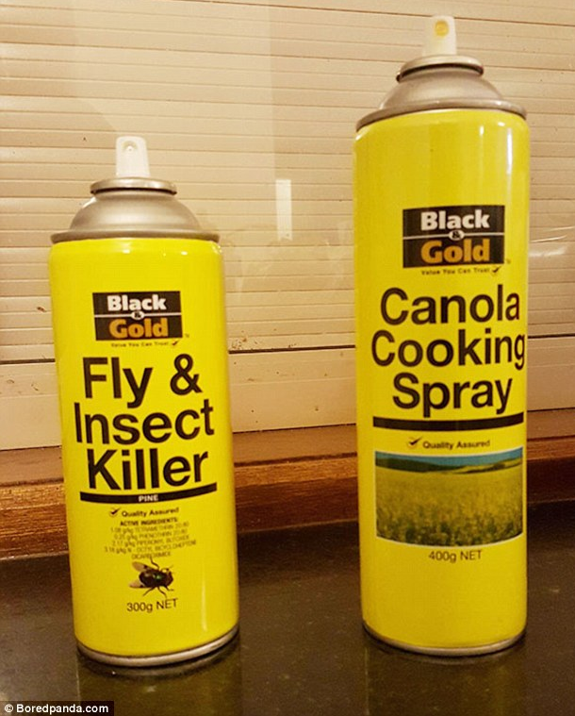
One way to the ER?

Slide 11
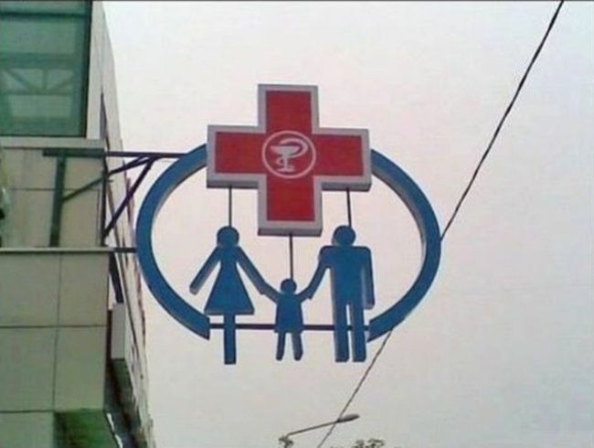
Better get a life insurance

Slide 12
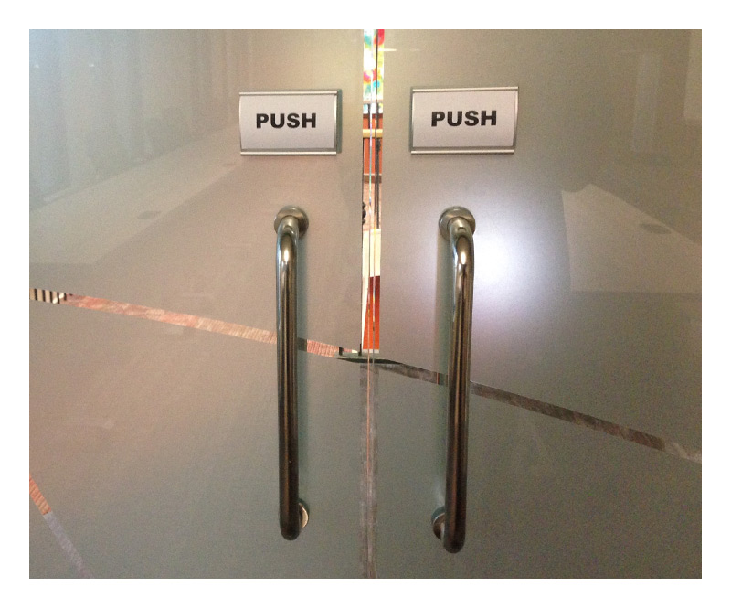
Doors!

Slide 13
Good design is important!
Bad designs are easy to find, good design much harder
Good designs (very subjective):
Easy, natural & engaging interaction
Users can carry out their required tasks
Accounts for human limitations
Usefulness is often context-dependent!

Slide 14
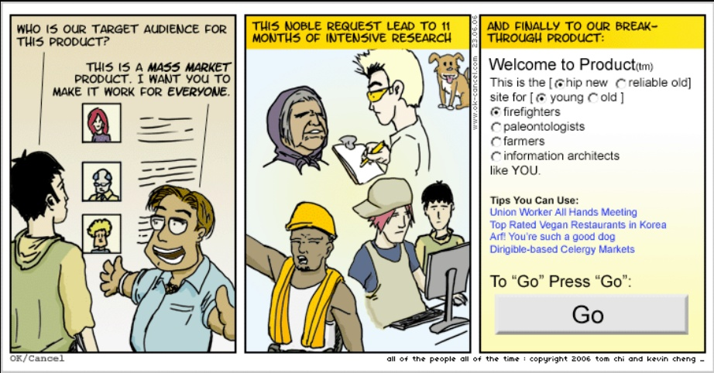

Slide 15
Why are so many mistakes made?

Slide 16
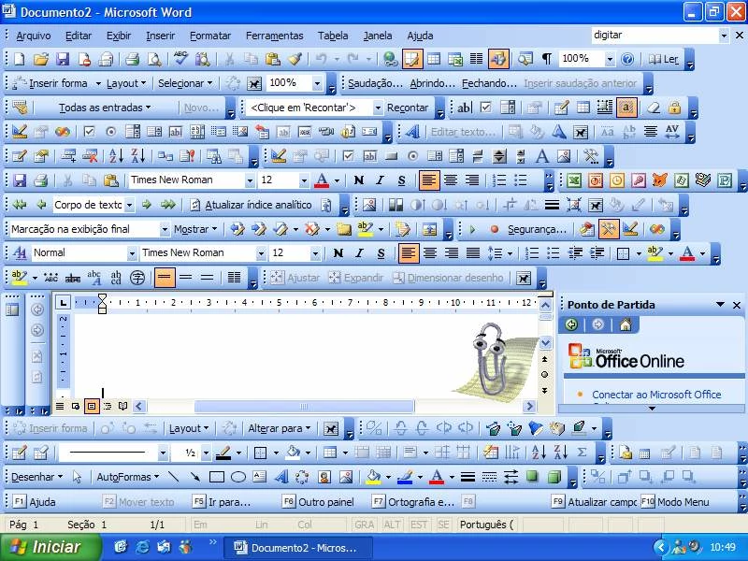
Featurism

Slide 17
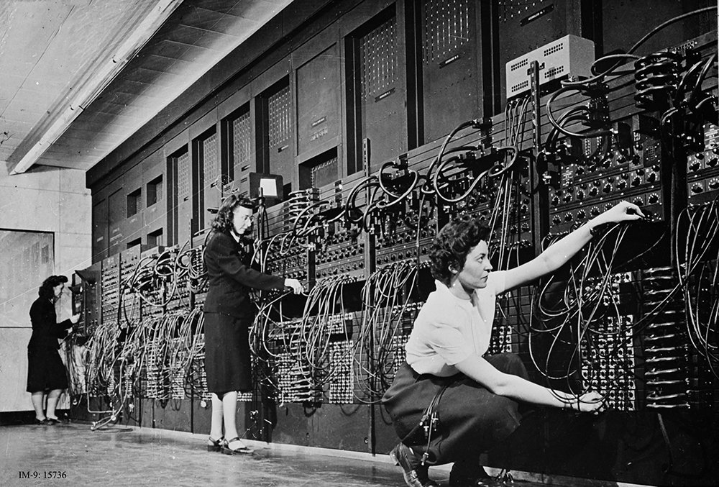
Machine-Oriented

Slide 18
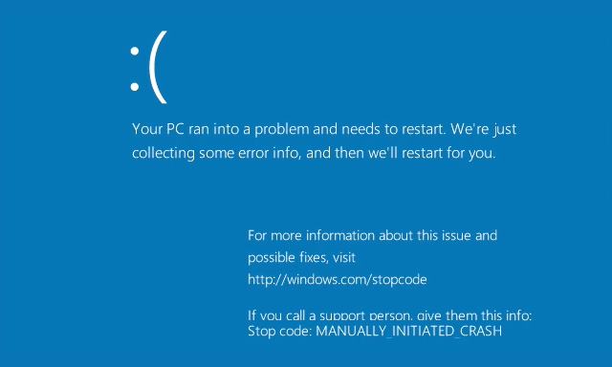
Premature Product Releases

Slide 19
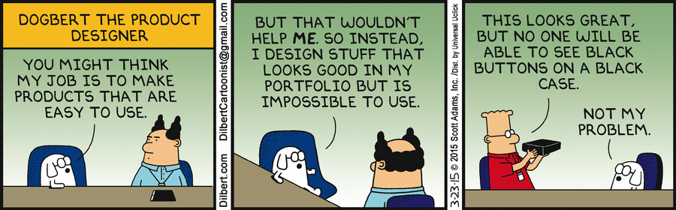
“Next-Bench” Design

Slide 20
The designer is NOT the user!

Slide 21

Technical and Human-Oriented Skills

Slide 22
Technical and Human-Oriented Skills
YES – that’s you!

Slide 23
What you will learn
How to design
What to select
How to evaluate

Slide 24
Three User-Centered Design Principles
Early focus on users and tasks
Empirical measurement of product usage
Iterative design

Slide 25
User-Centered Design Cycle
Problem Analysis
Design Realization
Design Evaluation
Design Generation

Slide 26
Problem Analysis
Developing user experience goals and objectives
Creating user profiles and personas
Executing user experience research activities, such as interviews and field studies

Slide 27
Design Generation
User walkthroughs of low-fidelity prototypes (e.g., paper)
Heuristic evaluations
Execution of user experience research activities, such as focus groups and card sorts

Slide 28
Design Realization
Preparation, planning, and execution of pre-product release heuristic evaluations
Preparation, planning, and execution of pre-product release usability testing

Slide 29
Design Evaluation
Usability testing
Surveys or interviews to gain feedback on released code
Field studies to see the product being used in its environment

Slide 30
KEEP ITERATING!

Slide 31
User-Centered Design Cycle
Problem Analysis
Design Realization
Design Evaluation
Design Generation

Slide 32
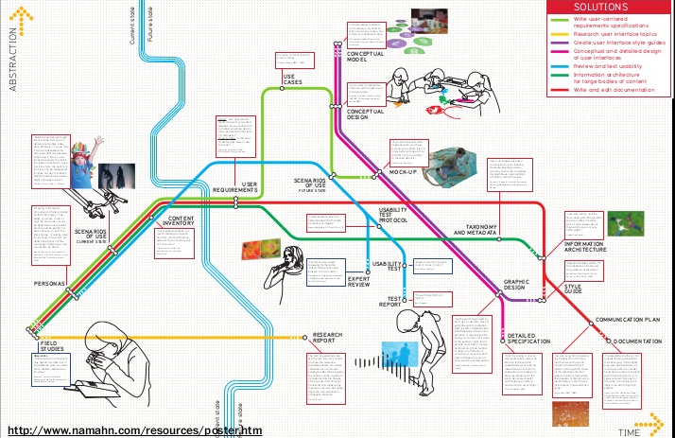
Life Cycle

Slide 33
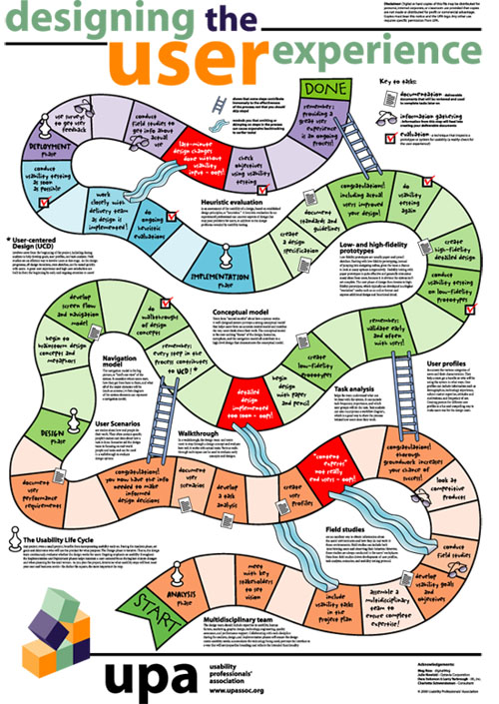
Life Cycle

Slide 34
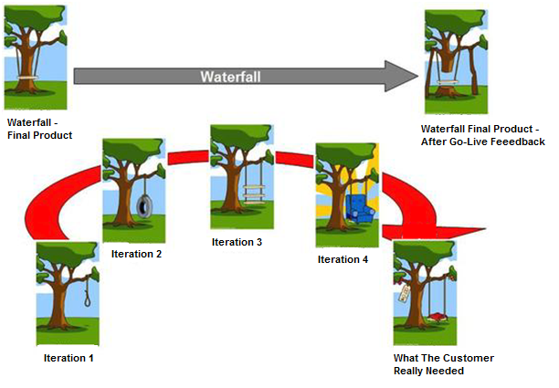
User-centered design

Slide 35
Designing with the user in mind
Usability
User Experience (UX)

Slide 36
What is Usability?
Usability
Something is usable when it is functional, efficient and desirable to its intended audience
Usability (ISO DIS 9241-11)
The extent to which a product can be used by specified users to achieve specified goals with effectiveness, efficiency and satisfaction in a specified context of use.

Slide 37
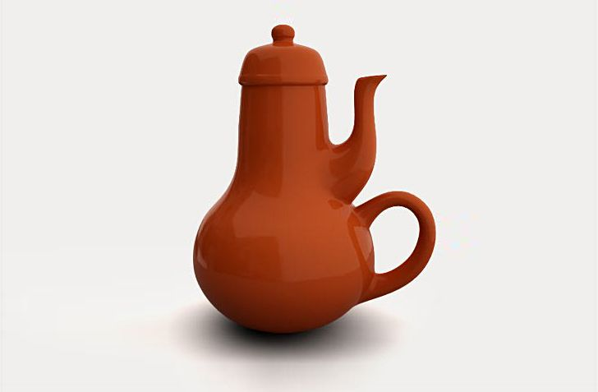
Good Usability?

Slide 38
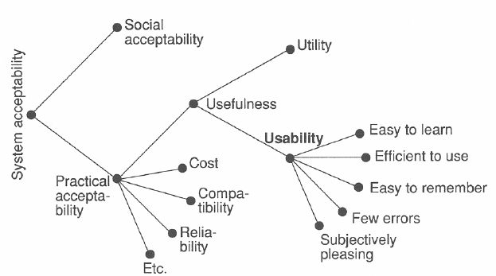
Model of System Acceptance

Slide 39
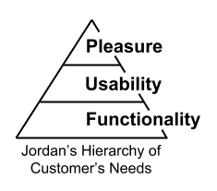
Hierarchy of Consumer Needs
“When people get used to something, they want more” (Jordan, 2000)

Slide 40
What is UX?
“The process of enhancing user satisfaction with a product by improving the usability, accessibility, and pleasure provided in the interaction with the product.”
(Sari et al., 2014)

Slide 41
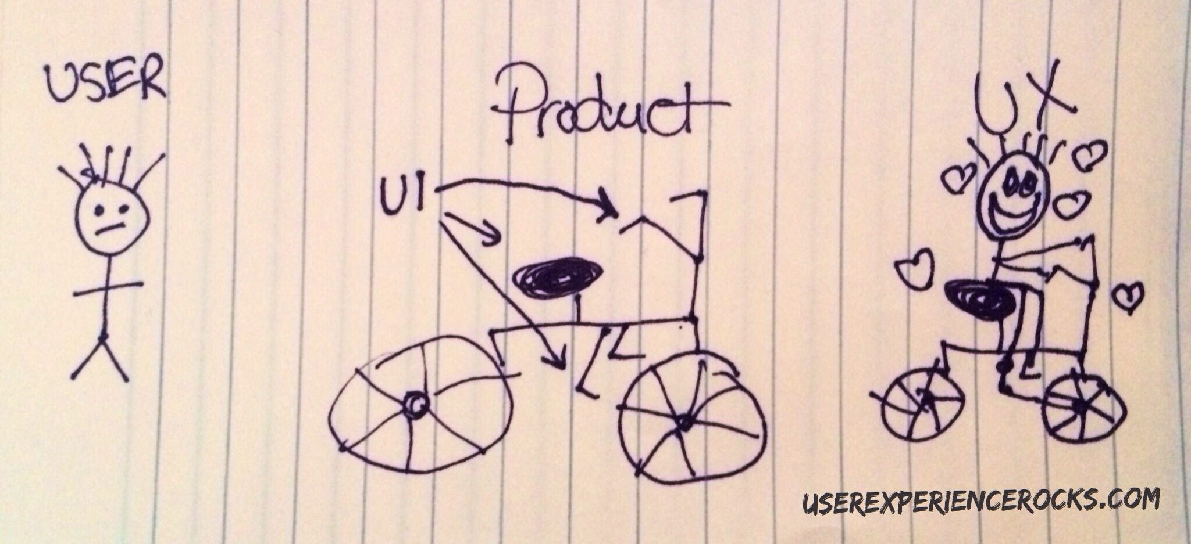
UX!

Slide 42
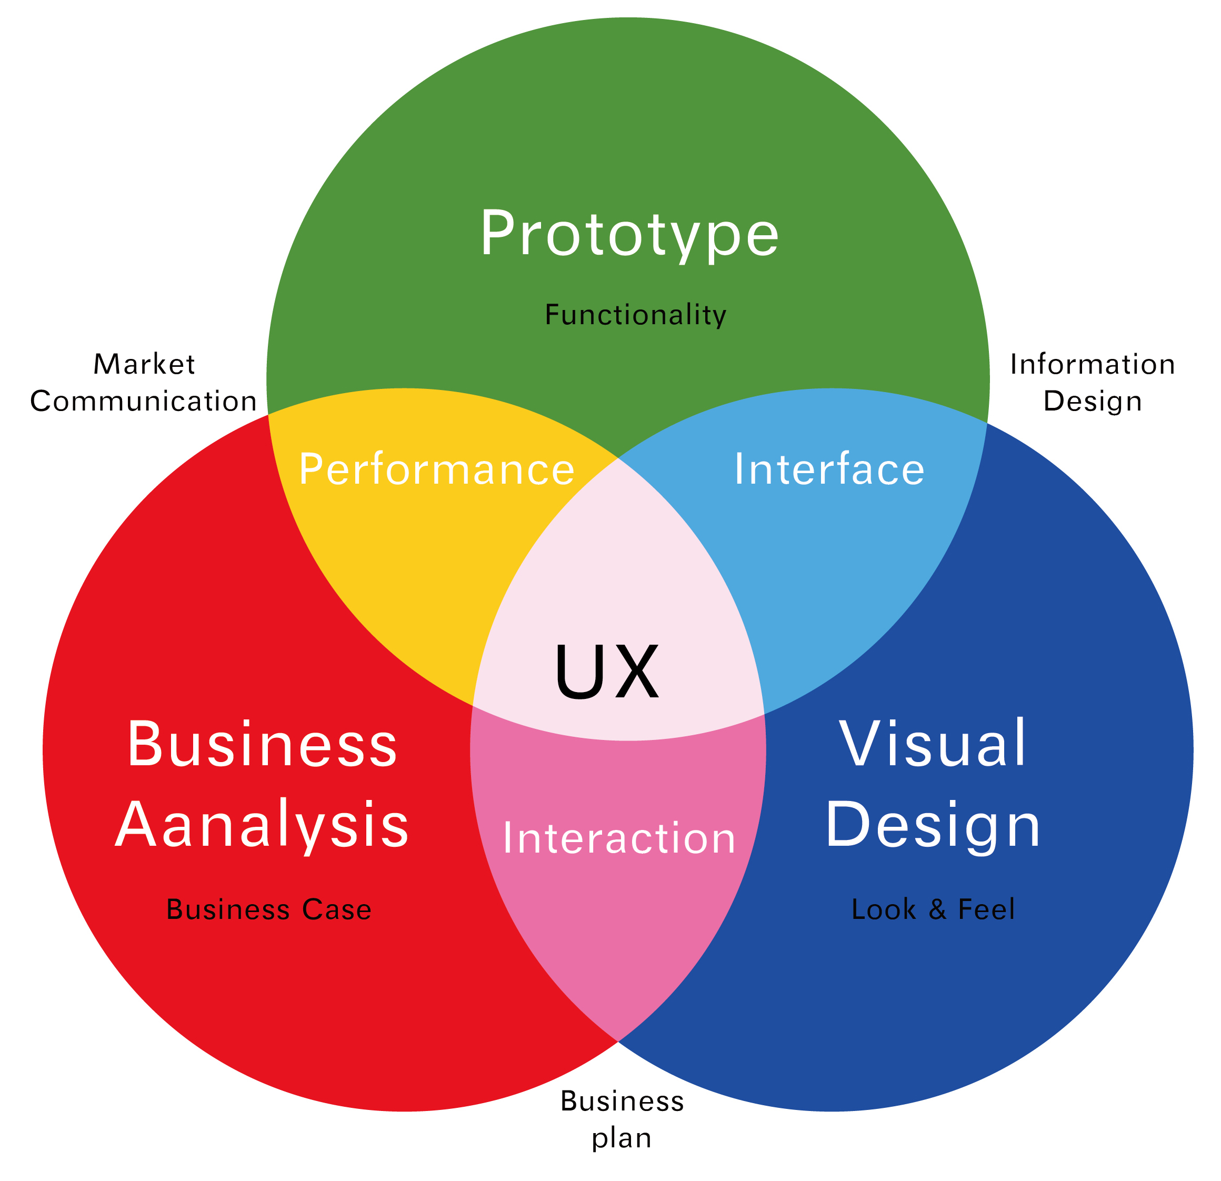
UX Disciplines

Slide 43
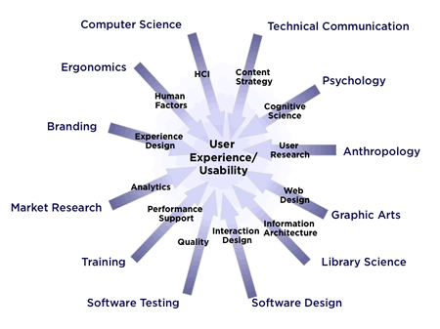
UX Fields

Slide 44
Usability vs. UX
Usability | ux
Making a task easy and intuitive | Making a task meaningful and valuable
Minimizing steps and removing roadblocks | Creating emotional connection
What users do and how they do it | What users feel

Slide 45
Wrapping up
Many of the human error and machine misuse is caused by bad design

Slide 46
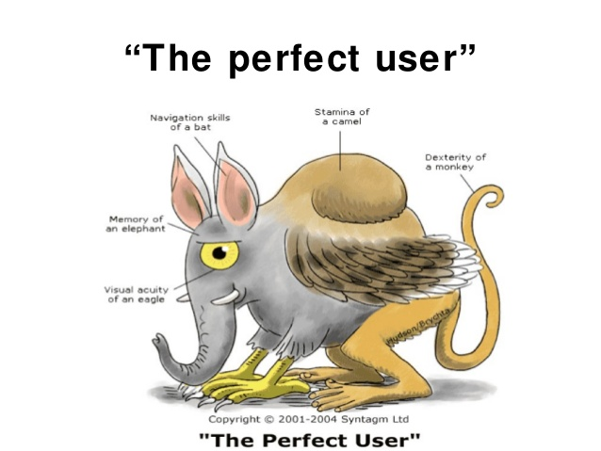
Wrapping up

Slide 47
Wrapping up
Users usually:
Get confused
Have lousy memory
Do not always see everything
Get tired and bored
Do not always pay attention
Get easily distracted

Slide 48
Wrapping up
But machines keep on offering more:
Form factor
Ubiquitous
Pervasive
Broadened user base

Slide 49
Wrapping up
The designer is NOT the user!

Slide 50
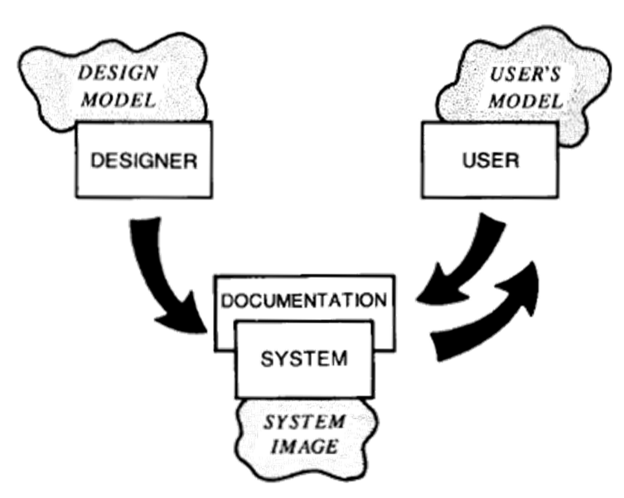
Wrapping up
Design model
conceptual model on which the design of the system is based
User’s model
model that the user develops on the basis of expectations and experience with the system
System image
all aspects of the system that the user experiences

Slide 51
